Slide 1






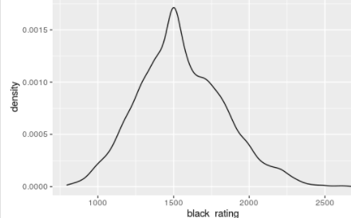
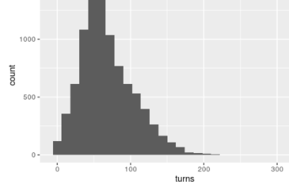
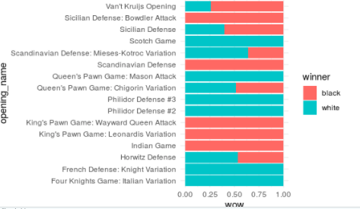
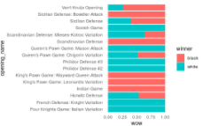
How The Outcome Of A Chess Games Are Determined
Nadrata Abdul-salam
Affiliated institutions
ABSTRACT
RESULT
CONCLUSION
The games.csv dataset has about 20,00 information on chess games played. The dataset includes many variables like; the player’s id, moves, ratings, turns, victory status , openings(position carried out within the first moves made by black and white pieces) etc..I want to predict the result/winning possibility and develop an understanding
100% of white players who the Queens pawns/mason attack, Philidord defense 2&3 ,French defense etc won the game. Players with ratings between a 1000 and 1500 new more likely to win a game
The type of opening affects an outcome of a game because it helps you understand your opponents move which gives you a higher probability of winning a game. The ratings determines what type of player you’re going against and can differ with each game depending on whether the player won or loss. the type of moves,turns,ratings and opening strategies leads to higher probability of wining in a chess game.
OBJECTIVE
What factors leads to a higher probability of a winning game? Can winning probability change with different ratings Does the type of opening affect an outcome of a game
METHOD
Download dataset into Rstudio Clean and filtered data Visualized dataset using ggplot Analyzed and ranged data Determined the different openings that can affect the probability of winning in a chess game
BIBLIOGRAPHY
Mitchell J Nadrata Abdul-salam Linchess API

